Slide 1
Single Family Housing is Unaffordable
House price to income ratio, %
 | 2025 | 2019
United States | 4.93 | 4.14
San Francisco | 12.19 | 12.62
Los Angeles | 9.69 | 8.22
Miami | 8.70 | 6.82
Seattle | 7.22 | 6.31
Boston | 6.54 | 5.35
D.C. | 5.40 | 4.78
Milwaukee | 5.15 | 4.14
Chicago | 4.41 | 3.72
Atlanta | 3.94 | 3.25
Dallas | 3.92 | 3.83
Philadelphia | 3.92 | 3.32
Nationally, assuming house prices move sideways, it will take 3-5 years for incomes to increase enough to reduce the price-to-income ratio to 4x.
Sources: BEA, Freddie Mac, Moody’s Analytics

Slide 2
Fixed Mortgage Rates Remain Uncomfortably High
%
Mortgage rate spread has narrowed to just over 200 bps, but remains wide compared to the typical 175 bps
10-year Treasury yield is near 4.7%
Sources: Moody’s Analytics

Slide 3
Interest Rate Lock Eases (Painfully Slowly)
%
The typical monthly mortgage payment on an existing mortgage is nearly $2,00 compared with $2,500 on a newly originated mortgage.
Sources: BEA, Freddie Mac, Moody’s Analytics

Slide 4
A Housing Shortfall Of Nearly 2 Million Homes
Over/undersupply of housing units, mil
Sources: Census Bureau, Moody’s Analytics

Slide 5
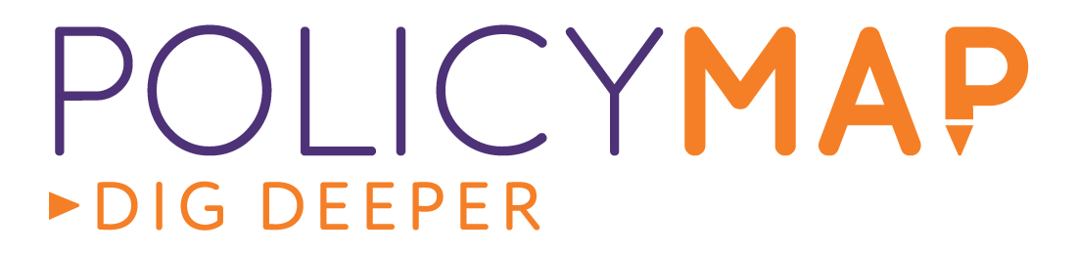
Reasons for Census Tract Level Analysis
National housing shortage data masks a deeper problem: housing isn't fungible. Units vary by cost, location, and tenure - and shortages and surpluses are unevenly distributed across the country.
National figures are of limited use for policy and investment. Housing decisions - where to build, what to build, and for whom - are made at the local level. A national number can't tell a city council, developer, or lender where the need actually is.
To cut through the noise, we analyzed cities at the census tract level to answer three questions:
  Where is housing most needed, neighborhood by neighborhood?
  Is the need for rental or owner-occupied housing?
  Do housing needs differ by neighborhood income level?

Slide 6
Overall Findings
We analyzed census tracts across 350 U.S. cities with populations over 100,000 - first in 2025, then again in early 2026. The findings were consistent across both years.
  These cities need 830,000 more housing units — a 2% gap.
  The shortage is primarily a rental one: 64% of needed units are rentals.
  Moderate- and middle-income neighborhoods are bearing the brunt: they contain 67% of existing rental units but account for 87% of the rental shortfall.
  High-income tracts need owner units and appear balanced in terms of rentals except in large cities where these tracts have a surplus of rentals.
  Low-income tracts appear balanced, which may be due to new construction that isn't actually affordable to residents and the long-term impact of affordable housing programs.

Slide 7
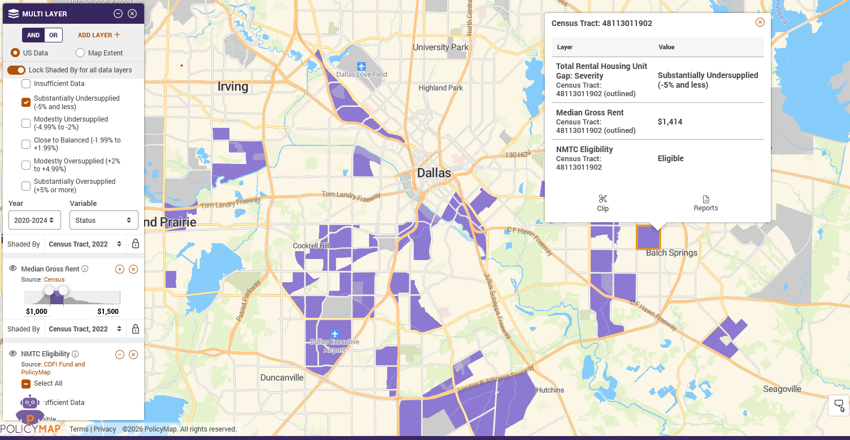
Pinpointing Development Oppo
- Highest need for rental units
- Median rent between $1,000 to $1,500
- Available tax incentives, like NMTC or Opportunity Zones

Slide 8

Measuring Housing Shortages In Cities
Analysis of the housing shortages at the tract level in cities is a Reinvestment Fund/PolicyMap adaptation of a logic created by a Moody’s-led team to estimate the housing shortage across the nation.
The logic builds on the notion that housing markets have equilibrium periods, and those equilibrium periods can be used as a standard against which current conditions can be measured.
  Nationally (and locally), that equilibrium period is 2012-2018:
    After the markets calmed from the housing market crash of 2010;
    Period of relatively steady interest rates, price appreciation and construction;
    Before the market upheavals associated with the COVID-19 Pandemic.
Also critical is how you define vacant (Yes: vacant for sale and vacant for rent; no: vacant sold (or rented) but not occupied; no: seasonal use; no: other vacant).
IJG Urban Advisors, LLC

Slide 9
Measuring Housing Shortages In Cities (continued)
Sample City Equilibrium Rates
IJG Urban Advisors, LLC

Slide 10
Measuring Housing Shortages In Cities (continued)
Neighborhoods with vacancy rates higher than the equilibrium period are over-supplied and those with vacancy rates below the equilibrium rate are under-supplied.
In most cities, shortages are more severe in the rental stock. And those shortages are disproportionately observed in lower, modest and middle-income areas.
  The market has generally provided more fully for the needs of higher-income owners and renters – and in fact, some of those areas within cities and across the country are over-supplied.
IJG Urban Advisors, LLC

Slide 11





While most places have significant shortages for renters, several places are now oversupplied – at least for some segments of the market

Slide 12
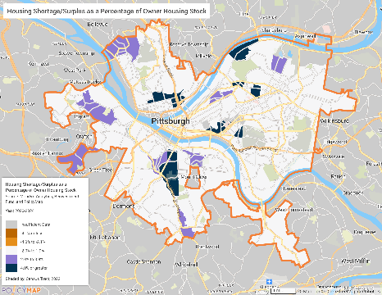
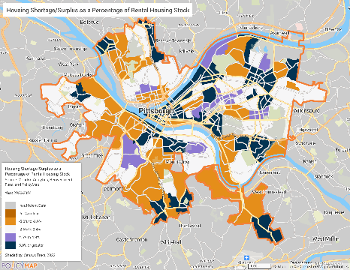
Pittsburgh: The owner market is largely consistent with the equilibrium level; large areas of the city though are modestly short of rental units
Owner Occupied
Renter Occupied
IJG Urban Advisors, LLC

Slide 13
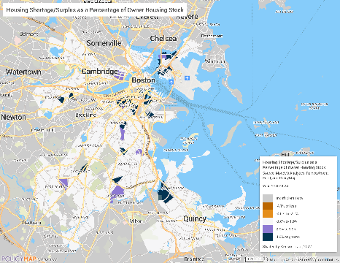
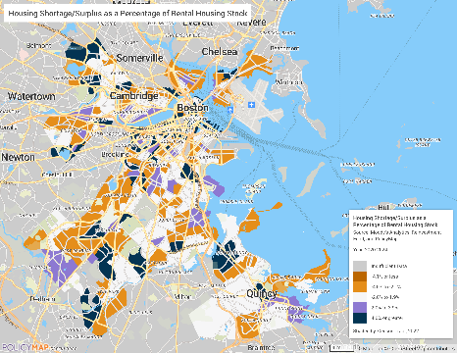
Boston: The owner market is largely consistent with the equilibrium level; much of the city though is modestly short of rental units while others are oversupplied
Owner Occupied
Renter Occupied
IJG Urban Advisors, LLC

Slide 14
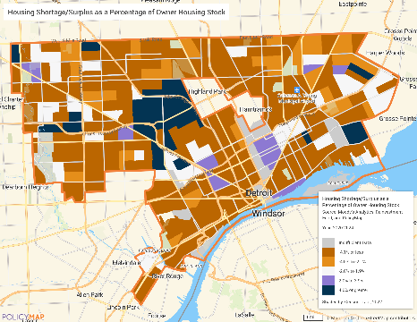
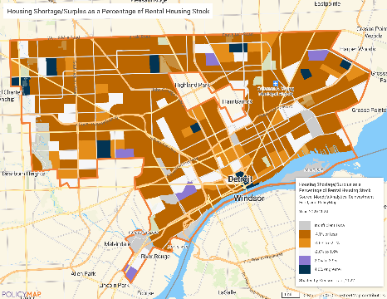
Detroit: Detroit’s shortages are substantial both in the owner and renter market.
Owner Occupied
Renter Occupied
IJG Urban Advisors, LLC

Slide 15
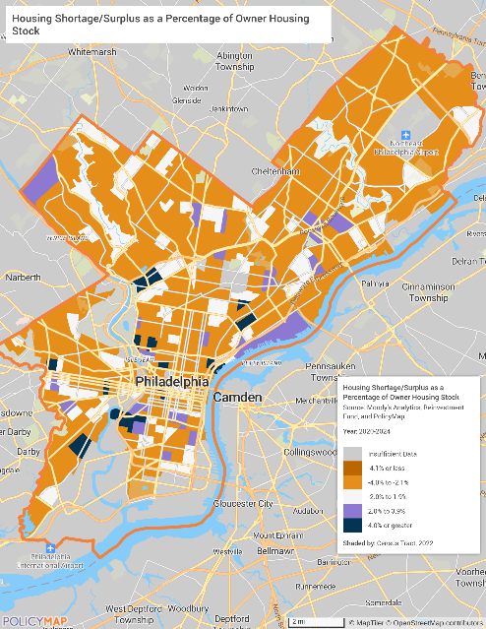
Philadelphia: The gap in the owner stock is modest through most of the city – and in short areas, the shortages increased modestly since the last estimates.
In areas that are short owner units, we estimate that the shortage totals 6,300 6,639 units;
In areas that are oversupplied the total overage is 1,515 1,726.

Slide 16
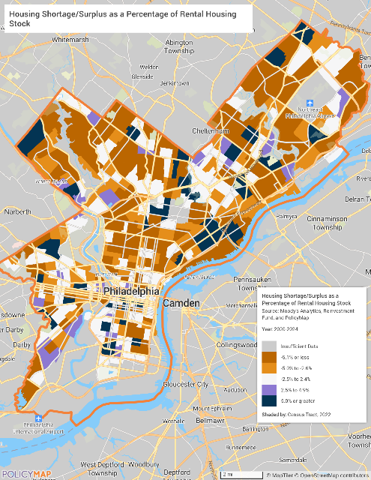
Philadelphia: Rental shortages are found throughout the city; oversupplied areas are largely in Philadelphia’s “hot markets”.
In areas that are short renter units, we estimate that the shortage totals 11,025 11,739units;
in areas that are oversupplied the total overage is almost 4,000 4,648.
Caution about how to disentangle a proper supply of housing units versus a proper supply of housing that people can afford.

Slide 17
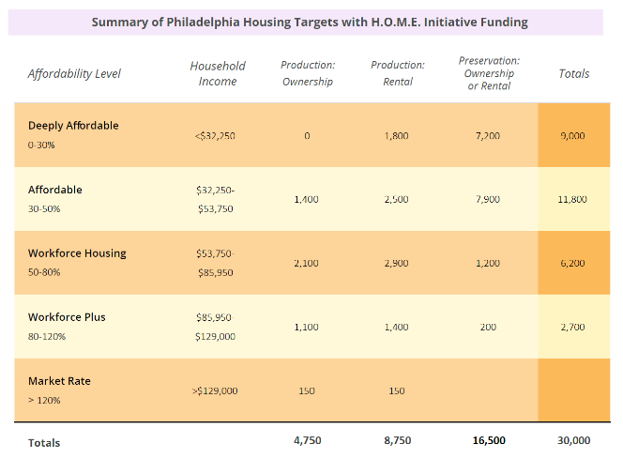
The benefit of gaps at the Census tract level: Apportioning the Gaps To the Typical Household Income In Each Census Tract
Estimating the number of properties with greatest need of preservation involved identifying properties with two of the following: (1) code violations; or (2) below (or worse) condition; AND (3) built prior to 1960; AND (4) very low assessed value.
H.O.M.E. targets were established to meet about 78% of the need for new construction and 78% for preservation need.

Slide 18
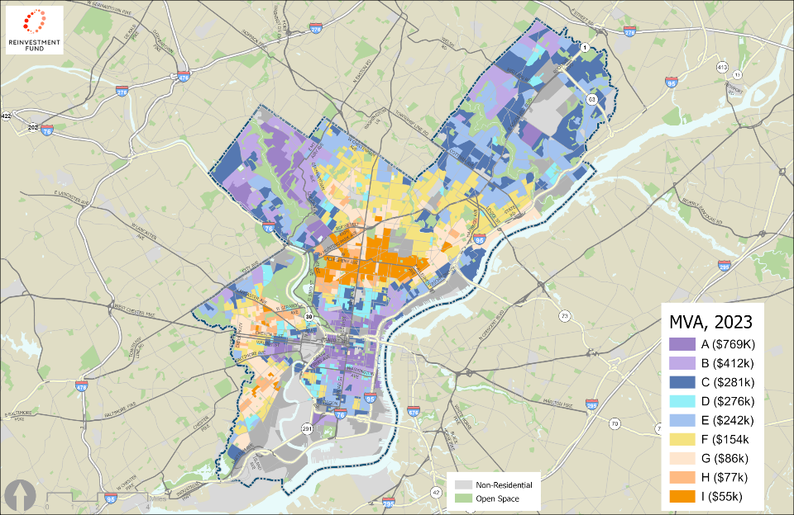
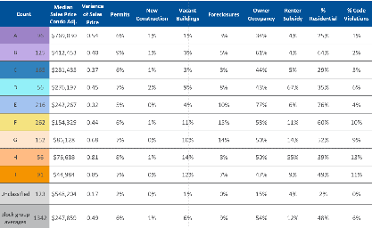
Many of the City’s housing tools are universally available, but some are more appropriate in certain markets.
Regional Choice
Strong Middle
Transitional
Lagging

Slide 19
Contact Information:
Ira Goldstein, Principal
IJG Urban Advisors, LLC
ira@ijgurbanadvisors.com
https://www.ijgurbanadvisors.com/
IJG Urban Advisors, LLC

Slide 20

NCST POLICY FORUM | JUNE 1, 2026
From Data to Doors
How Philadelphia Used Localized Housing Data
to Build the H.O.M.E. Initiative
Angela D. Brooks, FAICP
Chief Housing & Urban Development Officer
City of Philadelphia | Office of Mayor Cherelle L. Parker

Slide 21
Philadelphia's Housing Challenge
11,025+
6,300+
64,500+
Rental units short
(vacancy gap)
Owner units short
(vacancy gap)
Units affordable & available
to lowest-income households
PolicyMap/Reinvestment Fund
PolicyMap/Reinvestment Fund
Housing Initiative at Penn
88%
+61%
of lowest-income renters
cost-burdened or worse
rise in monthly
homeownership costs
2019-2024
PolicyMap / HIP at Penn
PolicyMap
Two lenses, one crisis: PolicyMap's vacancy gap data shows where supply is short. Penn's affordability analysis shows what low-income residents can actually access. Together they made the case for $2 billion.
2

Slide 22
PolicyMap Was Our Starting Point
How We Used the Data
The Questions It Helped Answer
Tract-level vacancy gap analysis
Mapped housing shortages by tenure (rental vs. owner)
Layered household income to identify affordability gaps by AMI band
Identified preservation need using code violations, building condition, age & assessed value
Used market typology (Transitional, Strong Middle, Lagging) to direct interventions geographically
Where is the city short on housing — by block and neighborhood?
Who is most affected — renters or owners, and at what income levels?
Where should we build new vs. preserve existing?
Which City tools are best suited for which market conditions?
Which communities — Black middle-class, immigrant working families — have been systematically underserved by private markets?
3

Slide 23
The H.O.M.E. Initiative: A Data-Driven Response
$2B
30K
Data-Informed Programs
Turn the Key
committed
housing investment
homes to create
or preserve
New homeownership on City-owned lots
One Philly Mortgage
Down payment & rate assist. — median home up 37% since 2019
"The data told us the why.
H.O.M.E. gives us the how."
Basic Systems Repair
Emergency home repair preservation
Restore Repair Renew
Homeowner rehabilitation loans
— Angela D. Brooks, FAICP
Special Disposition
~500+ public parcels for first-time buyers
Middle Income Catalyst Fund
60–100% AMI gap financing
4

Slide 24
Matching the Right Tools to Market Conditions
Reinvestment Fund's market typology framework helped us target our interventions. Not every neighborhood needs the same solution.
Strong Middle
Transitional
Lagging Markets
Regional Choice
Support homeownership demand.
One Philly Mortgage, first-time
buyer programs.
Catalyze investment with gap
financing. Middle Income Catalyst
Fund, mixed-income development.
Preservation-first approach.
Repair programs, land bank
disposition for affordable housing.
Prevent displacement. NOAH
preservation, affordable rental
retention strategies.
This geographic precision prevents us from applying blunt citywide policies that miss where investment is truly needed most.
5

Slide 25
Turning Data into Policy & Action
01
02
03
04
Diagnose
Design
Legislate
Deploy
Tract-level gap
analysis via PolicyMap
identified where &
for whom
Programs calibrated
to income bands:
30%, 50%, 80%,
100% AMI targets
H.O.M.E. Ordinance
passed by Council;
bond funds & City
resources committed
6 partner agencies
aligned + 100+
regulatory/process
reforms underway
Key takeaway: Data doesn't replace political will — it builds the case for it. Reinvestment Fund & PolicyMap gave us the evidence to align City Council, philanthropic partners, and community stakeholders around a shared housing agenda.
6

Slide 26

Data Tells a Story.
Philadelphia Is Living It.
• PolicyMap & Reinvestment Fund gave us the vocabulary to describe a housing crisis in terms policymakers, funders, and residents could all understand.
• H.O.M.E. is the response — a $2B, 30,000-home plan grounded in data and delivered through partnerships.
• The work is ongoing — and every phase continues to be guided by data.
Angela D. Brooks, FAICP
Chief Housing & Urban Development Officer
City of Philadelphia
Angela.d.brooks@phila.gov
City of Philadelphia | Mayor Cherelle L. Parker | H.O.M.E. Initiative

Slide 27
To Access the Data
The study and the data for the 350 cities can be found via www.policymap.com
Data is available in the mapping application as well as within data packages, including on Snowflake.
We’ve prioritized making data AI ready so that it can be accessed and analyzed outside of PolicyMap using AI chatbots.

